Slide 1






Employment Income Trends Changes from 2017 to 2018
Adrianne Miller
Julia Sebring
Dorna Shakoory
Gideon Victor

Slide 2


Agenda
Dorna Shakoory
Overview
Proposed Questions
Background Info
Raw Data
Data Wrangling
Data Munging and Cleanup
Analysis
Data Visualization
Q&A

Slide 3


Our focus
What has changed in the US job Market from 2017 to 2018
Many people are encouraged to pursue trending jobs with the expectation that their salary will be increased...
Will Data or our Visualization agree with this hypothesis?

Slide 4
Proposed Questions
What happens to income when number of jobs grow?
Which industries are trending and what do their incomes look like?
Where does data analytics rank in growth and income?

Slide 5
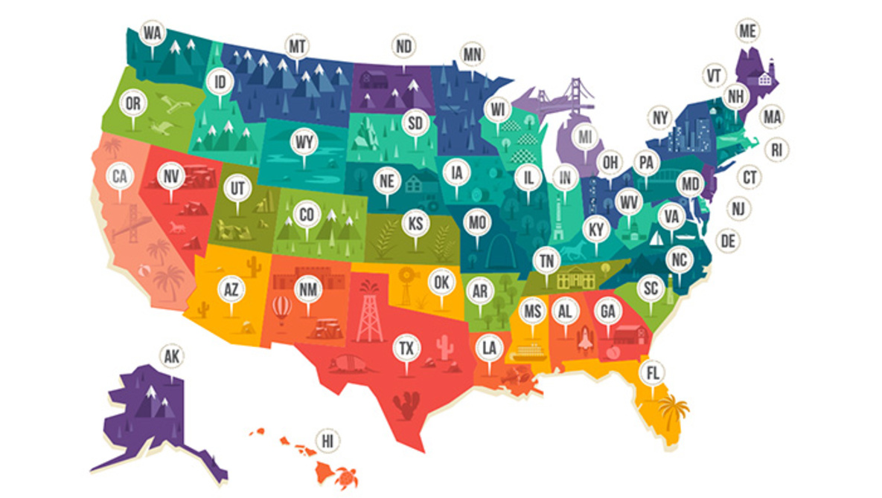
Raw Data
Bureau of Labor Statistics(BLS)
https://www.bls.gov/oes/tables.htm/
Occupational Employment Statistics
Reviewing the OES data for both recent
2017
2018
Focused exclusively on data for the 50 states
Created Data Frames that look at industries
Nationwide
By State

Slide 6
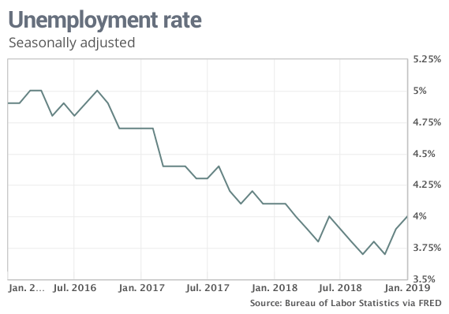
Background Information
Unemployment
Inflation
GDP
2016
4.9%
2.1%
1.6%
2017
4.7%
2.1%
2.2%
2018
4.1%
1.9%
2.9%
Notes:
JS googled this information; need to verify and cite source in final presentation

Slide 7
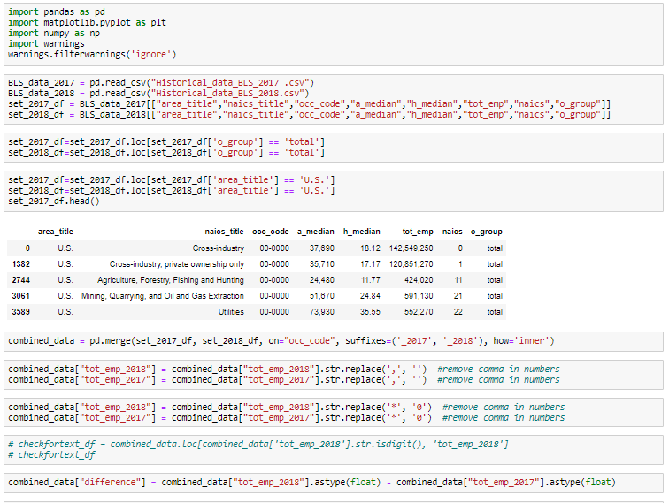
Importing the dependencies
Gideon Victor
Data Munging and Cleaning

Slide 8
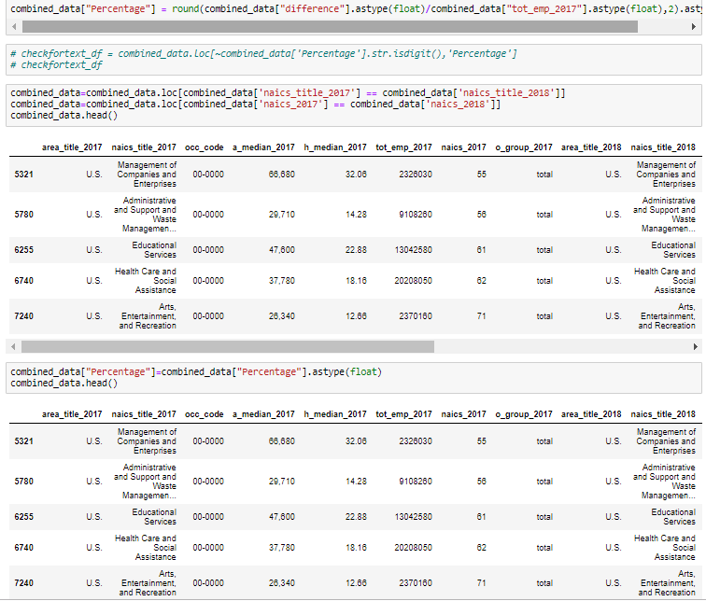
Data Wangling Process

Slide 9
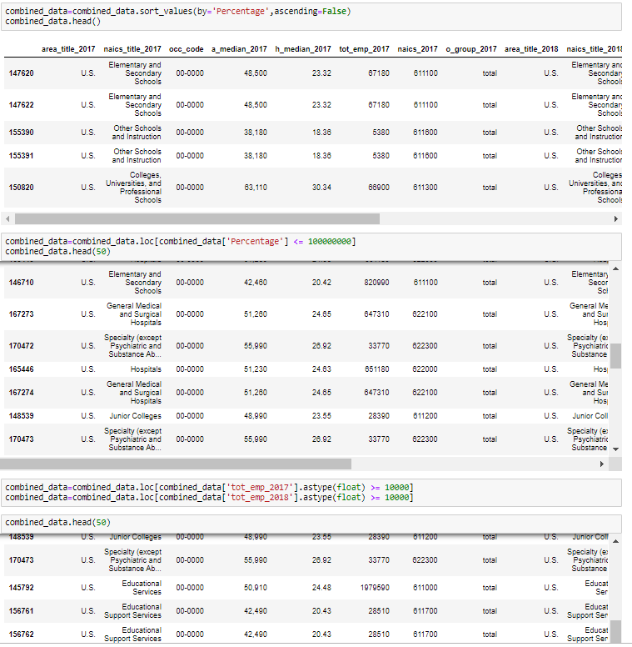
Merging cleaned Data from 2017 and 2018

Slide 10
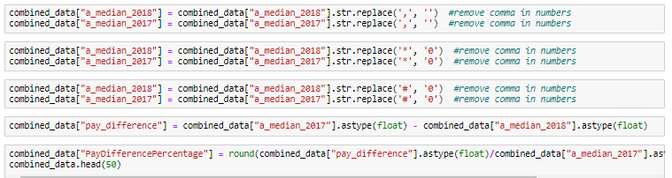
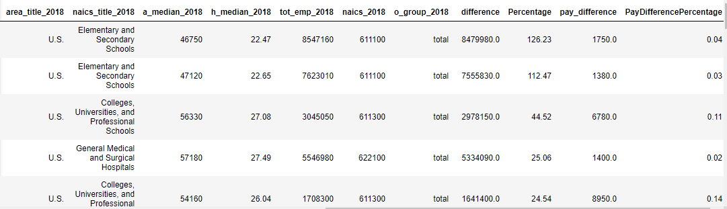
Adding Calculated Fields for further analysis

Slide 11

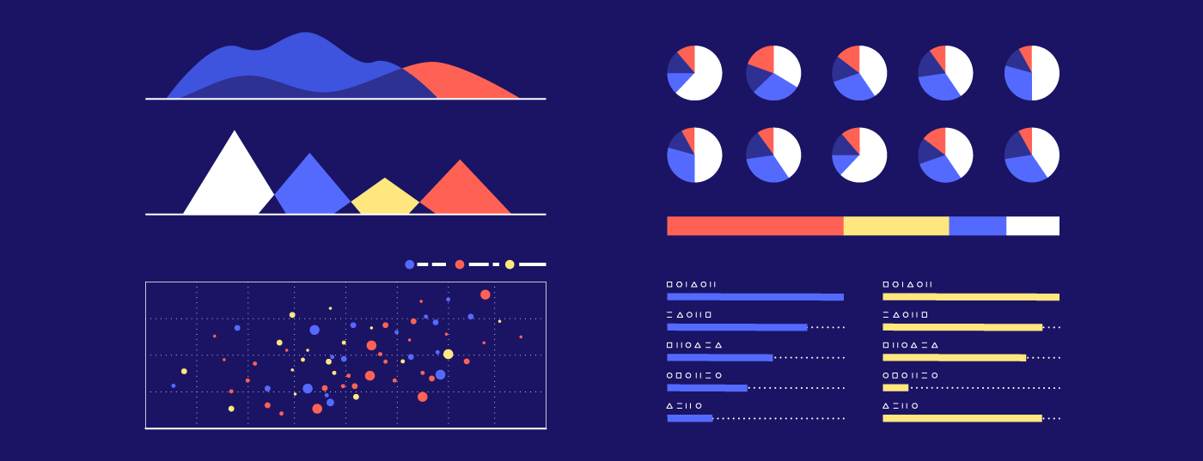
Data Visualization
Employment Rate
Median Annual Wage by State
Average Annual Income by Occupation
Julia Sebring

Slide 12

What happens to income when number of jobs grow?

Slide 13
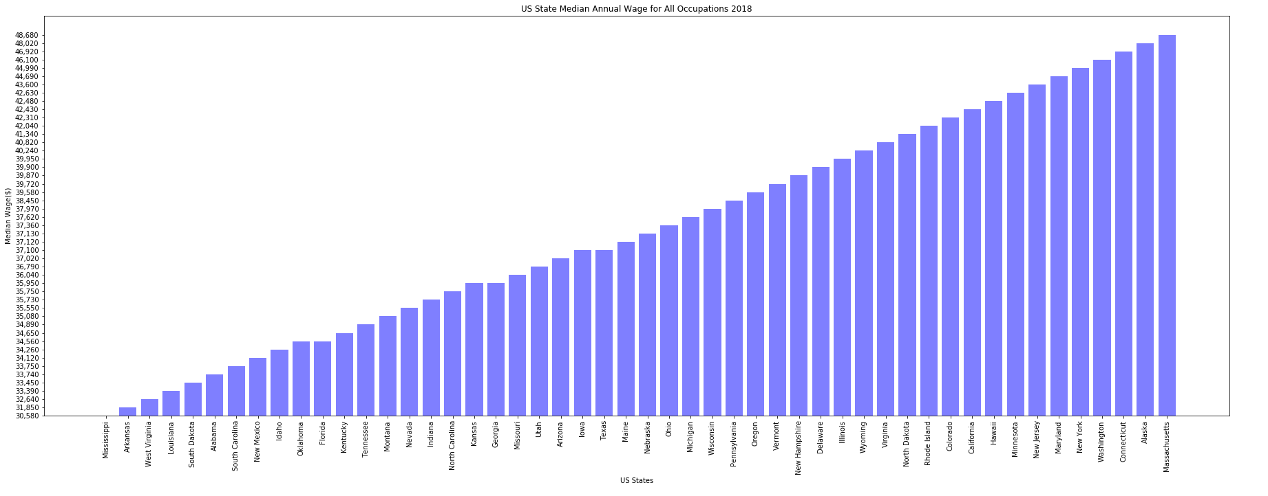
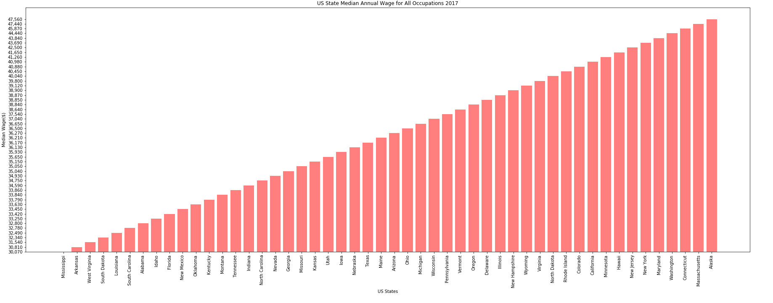
Median Annual Wage by State
Changes from 2017 to 2018

Slide 16
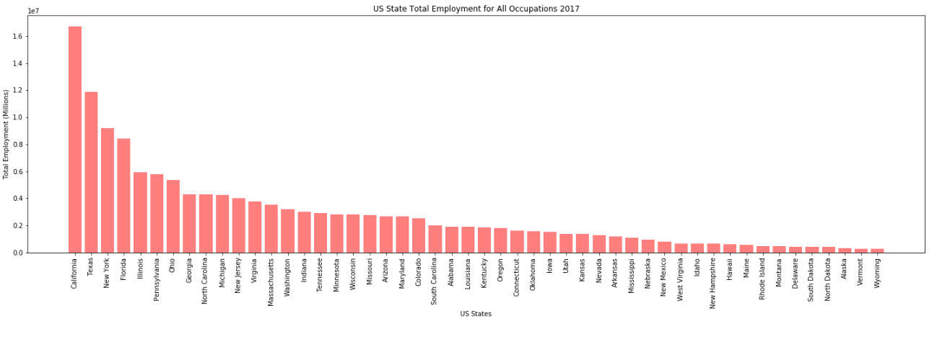
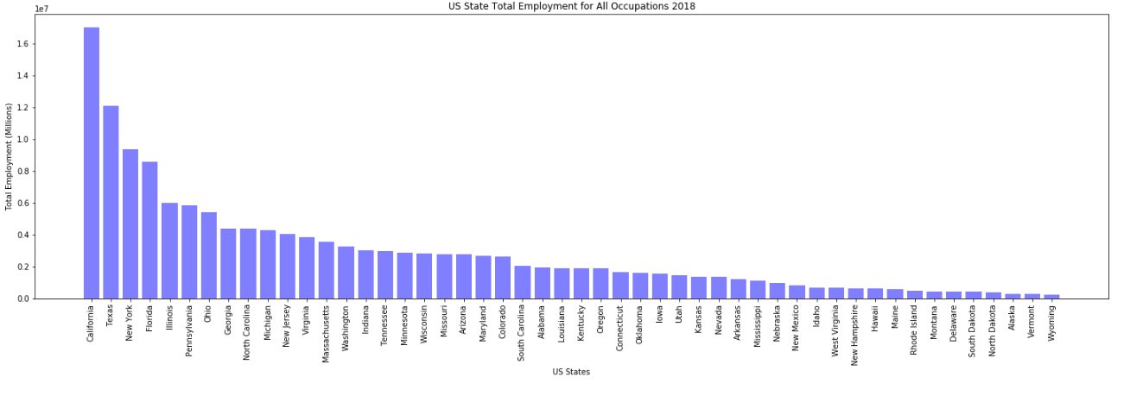
Total Employment by State
Changes from 2017 to 2018

Slide 17
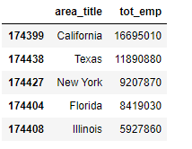

Slide 18
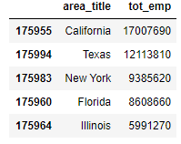

Slide 19
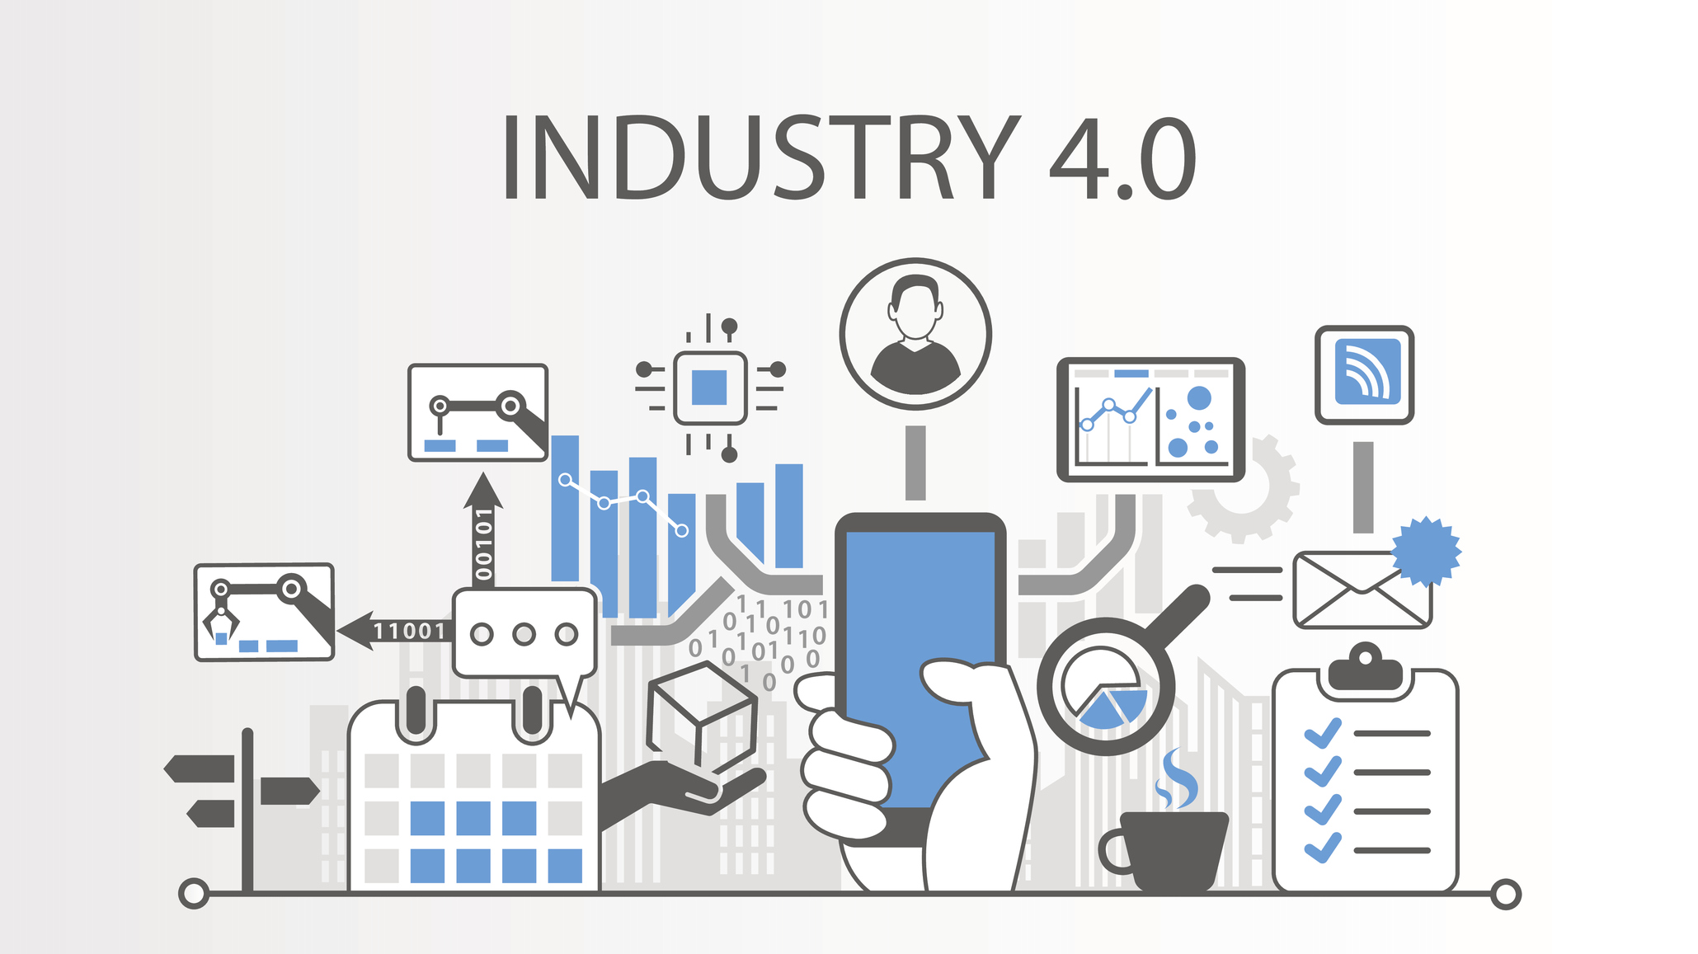
Which Industries are trending and what do their incomes look like?

Slide 20
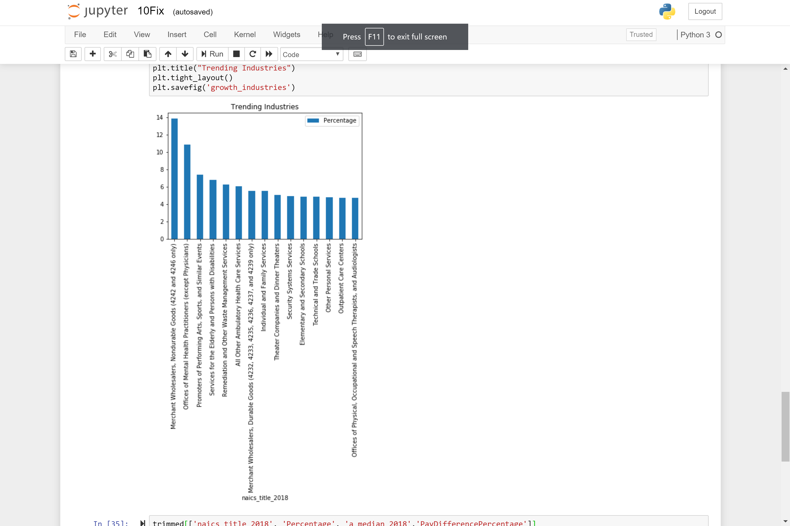
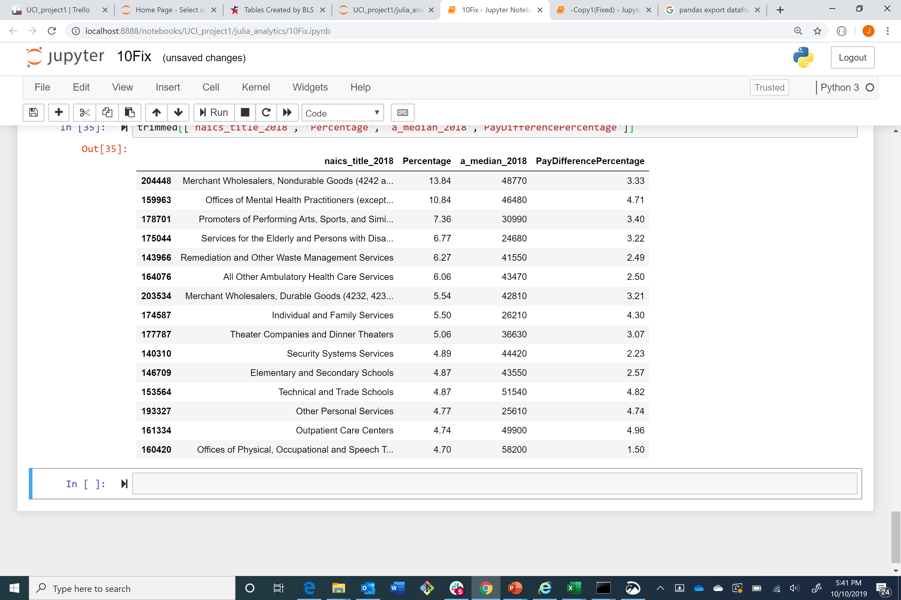
Trending industries
Which industries are trending and what do their incomes look like?

Slide 21
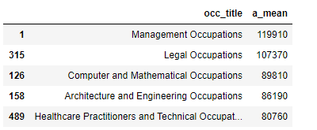
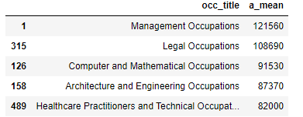
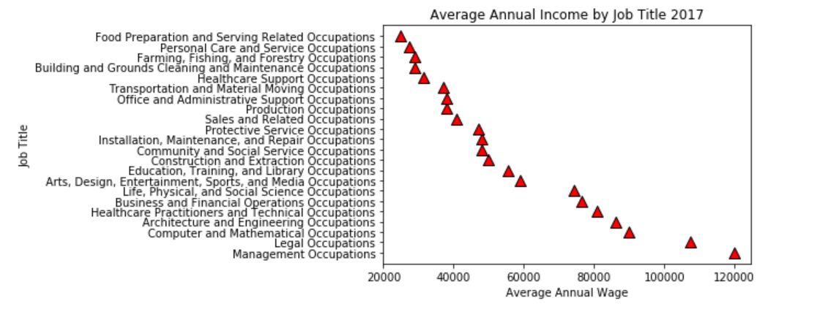
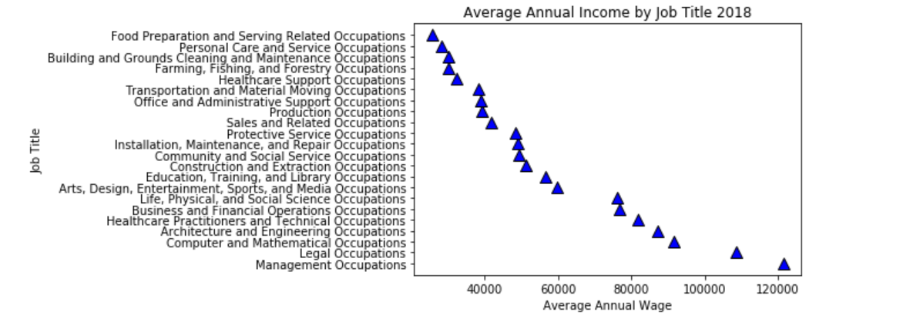
Average Annual Income by Occupation
Changes from 2017 to 2018

Slide 22

Where does Tech Industry rank in growth and income nationwide?
Is there any correlation between choosing a career in the Tech Industry and the income level?
Are we in a right career path?
Adrianne Miller

Slide 23
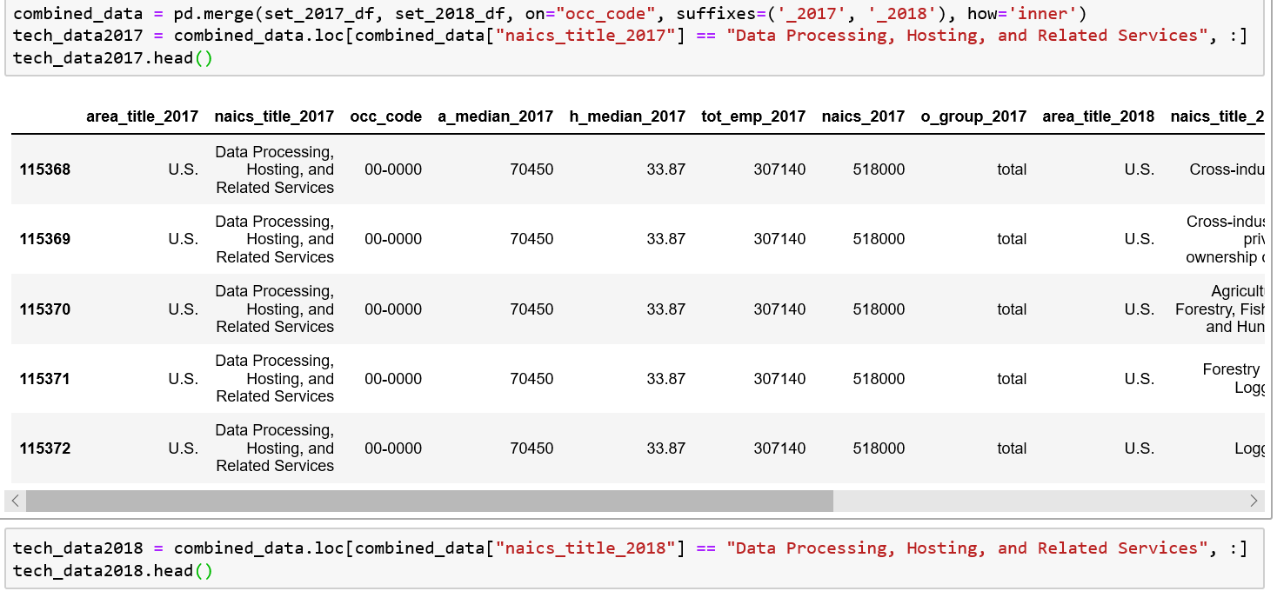
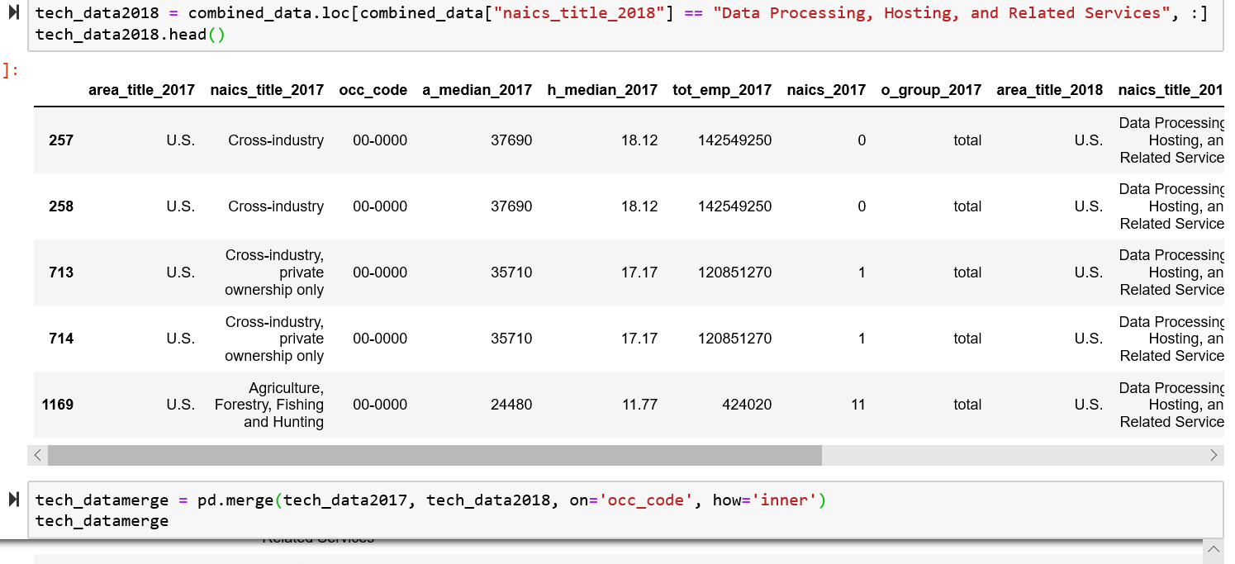
Status of Data Analytics in the Job Market

Slide 24
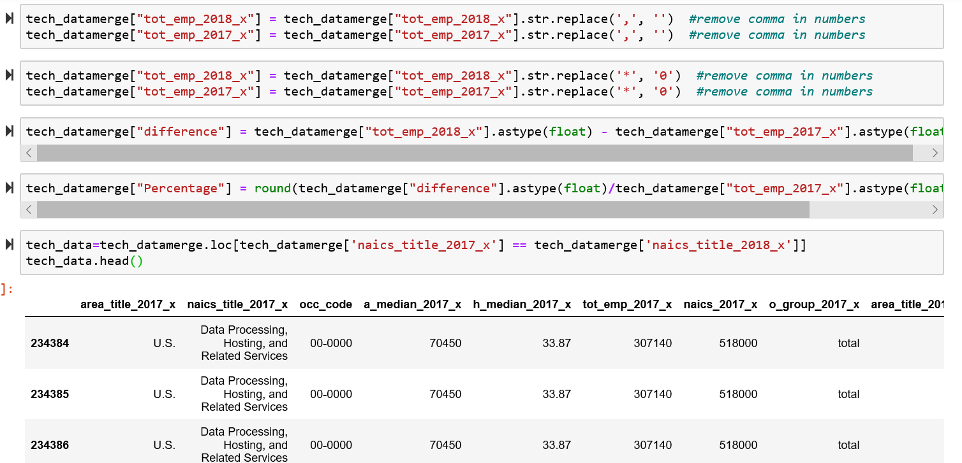
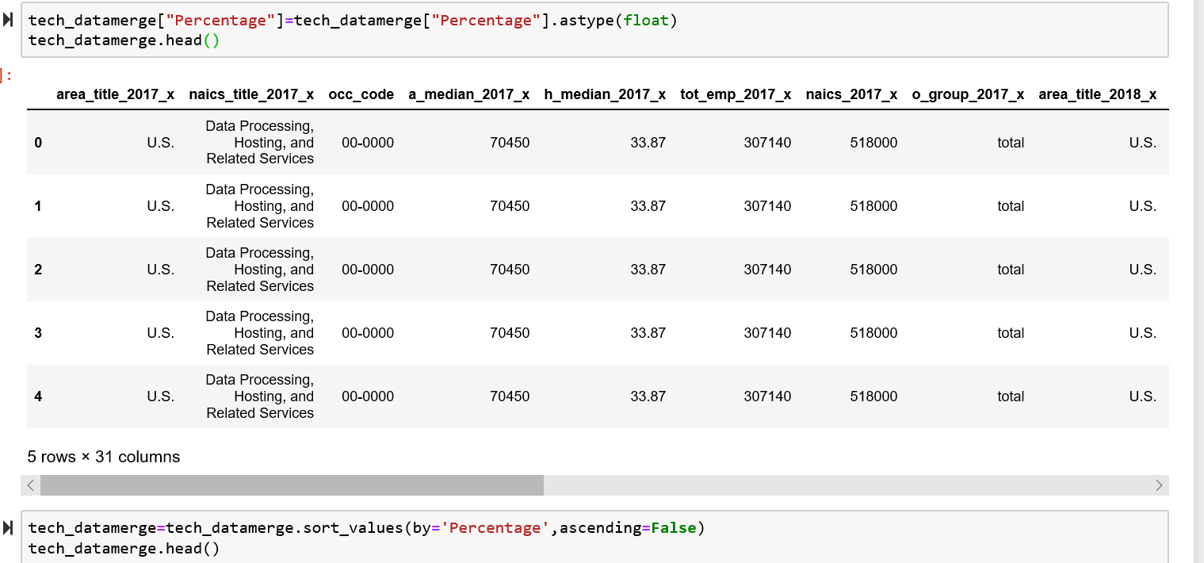
Data Wrangling and selection process

Slide 25
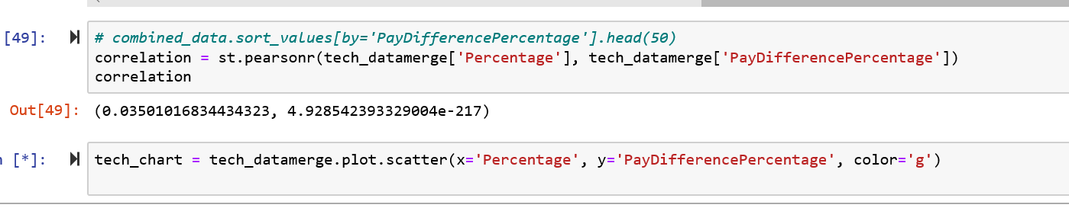
Will working in Tech Industry have any impact on the higher income level?
3.5% growth in data jobs
2.8% growth in median income

Slide 26
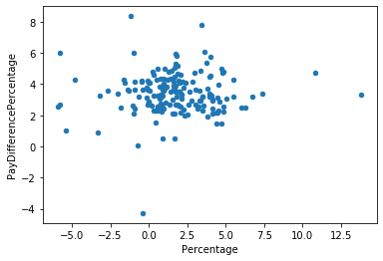
Does Growth in the Industry indicate Growth in Pay?
Gideon Victor

Slide 27

Adrianne Miller ◊ Dorna Shakoory Julia Sebring ◊ Gideon Victor
https://www.bls.gov/oes/tables.htm/

Slide 28

1. What is the one thing you have learned from this presentation
2. What would you do differently given the available data set?
3. What other plots would you recommend considering the available data?

